Slide 1
The project is prepared by Kairat and Janbolot
The name of the project is “guess the word”
This name focuses on the user having to guess the randomly generated word. We created the list of the words , which word would have to be guessed and also set a cap on the number of guesses allowed.

Slide 2
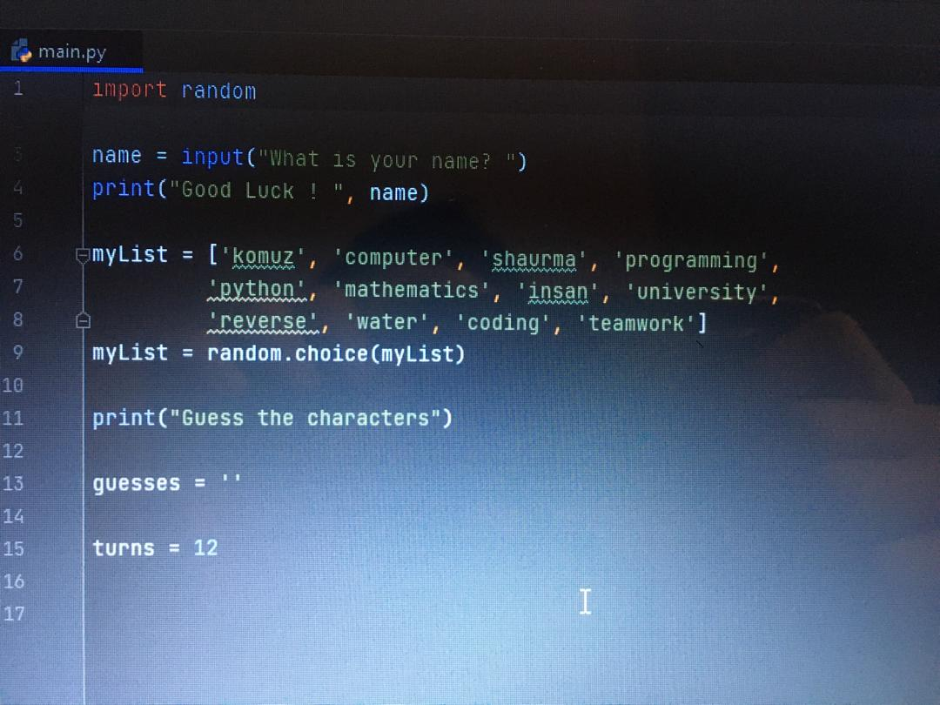
Introduction
Fitstly, we wrote introduction to our project by introducing yourself. The player writes his name. We created the list of the words which related to the our university live. So it randomly choose one of the words. You should guess the word by saying the characters of the word. One letter one attempt, all in all you have 12 allows.

Slide 3
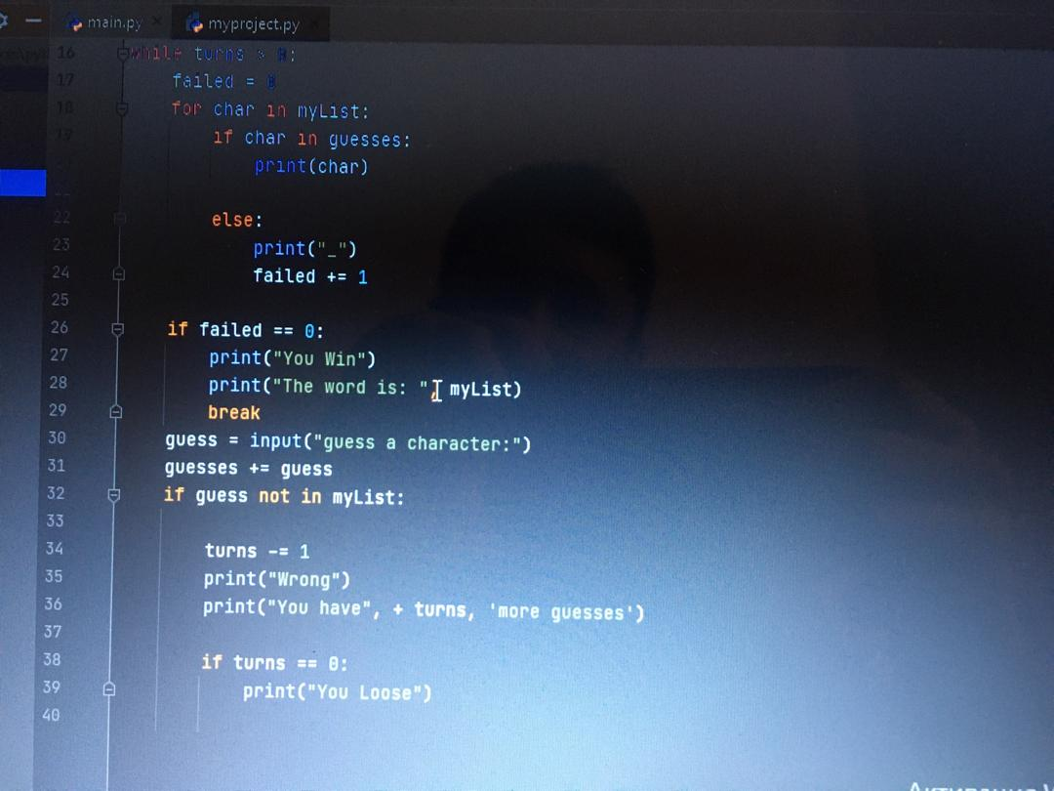
Next step is about fails and win. If you try the letter which is not in word, your attempts will decrease, we used the “While loop” for this, the program will ask you to enter other character. If the attempts gets 0, you will loose, but if you guess the word before the allowed attempts get to 0 you win

